Slide 1
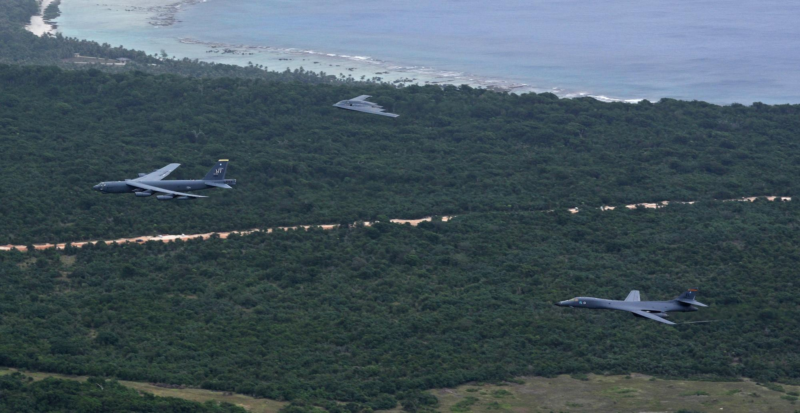

AIRLINE RESERVATION SYSTEM PROJECT
-Presentation by
Group 4
Mentor: Shankar Sir

Slide 2

CONTENTS
Introduction
DFD Diagram
Functions used in the Program
Brief Description of Code
Testing
Program Output

Slide 3

INTRODUCTION
The Airline Reservation System application can be used by Airlines and Travel agents to allocate seats to customers which replaces traditional methods of ticket booking.

Slide 4

Aim - To create the development of an Airline Reservation System application
Travel agents -> Customer Details
Admin -> Flights Details
Ticket Allocation
Report Generated

Slide 5
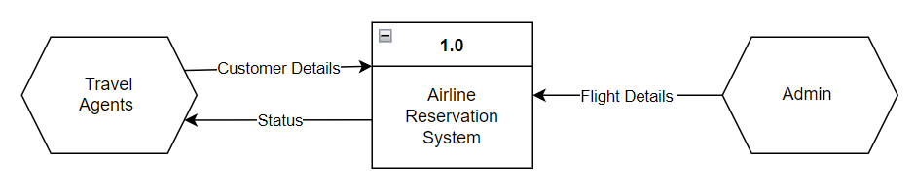
DATA FLOW DIAGRAM (Level 0)
Notes:
Travel agents provide the customer data to Airline Reservation System and Admin has the flight details info to pass on to the Airline reservation system.

Slide 6
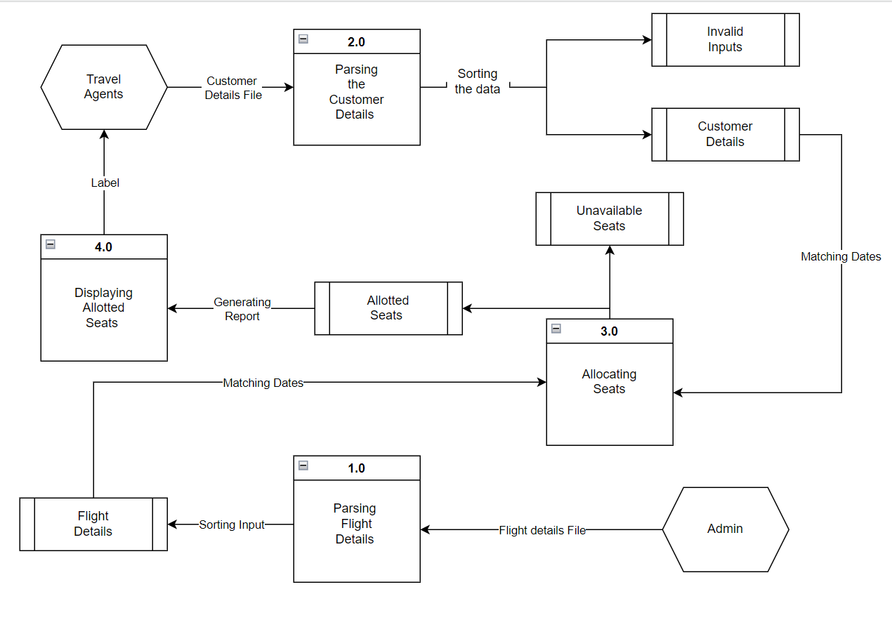
DATA FLOW DIAGRAM (Level 1)
Notes:
Travel agents provide the customer data to Airline Reservation System and Admin has the flight details info to pass on to the Airline reservation system.
First Admin reads the flightdata and sorts the valid flights.
Second the travel agents customer details data are read and sorted into valid and invalid customers. Invalid customers are then stored in invalid customers file.
Third the valid customer details are passed on to allocating tickets. Allocating tickets then allocates the tickets to the customers, if the tickets are not allotted then it is saved to Unavailable seats and if the tickets are allocated then we display the flight details and details of customers in the flight.
After the displaying the details we update it to the agents

Slide 7
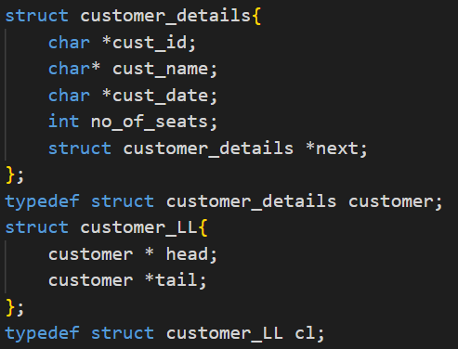
DATA STRUCTURES USED IN THE PROGRAM
Structure (typedef: customer) was created for customer details as shown in the figure.
It consists of Customer- Id, Name, Date, No. of seats & Next pointer
A linkedlist was created to store all the valid customers.
Notes:
We used 2 structs one Customer_details which has customer ID, customer name, date, no. of seats and the next pointer.
Then we created a struct that has a linked list whose each node is a customer_details struct, this customers_LL struct has head and tail.

Slide 8
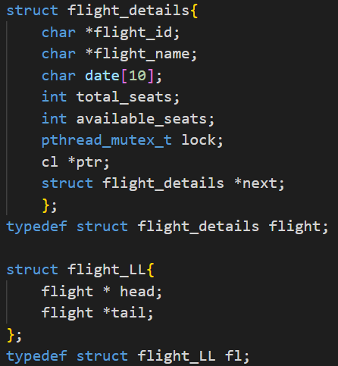
DATA STRUCTURES USED IN THE PROGRAM
Structure(typedef: flight) was created for flight details as shown in the figure.
It consists of flight Id, name, date , total no. of seats, available seats, mutex lock, customer pointer, next pointer
A global linkedlist was created to store all the valid flights.
Notes:
We used 2 structs for flights also one flight_details which has flight ID, flight name, date, total seats, available_seats, a customer details linked list pointer and the next pointer.
Then we created a struct that has a linked list whose each node is a customer_details struct, this customers_LL struct has head and tail.

Slide 9
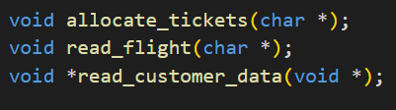
FUNCTIONS USED IN THE PROGRAM
Apart from main function, the other functions used in the program are as follows:
read_flight()- Read the flights file & store data in a global flight linked list.
read_customer_data()- Reads the input file, calls allocate function for valid customers & prints Invalid customer data.
allocate_tickets()- to finally allocate tickets to customers
Notes:
As discussed in the DFD level 1 we need 3 function Allocate_tickets, read_flight and read_customers_data.

Slide 10
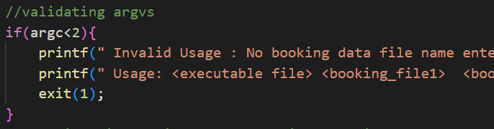
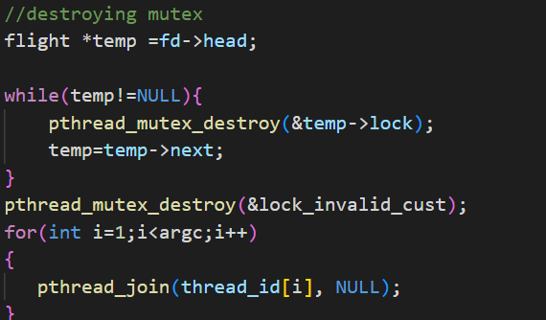
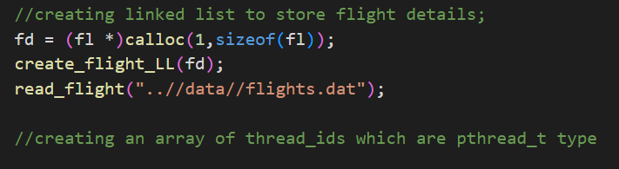
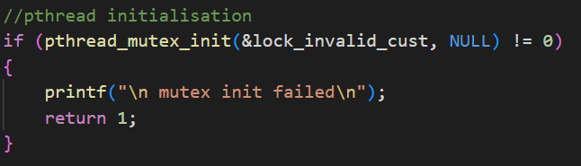
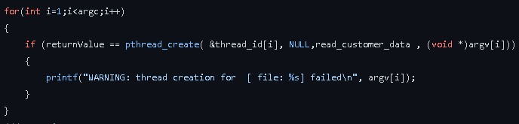
BRIEF DESCRIPTION OF CODE(MAIN FUNCTION)
Notes:
First we check if the no of command line arguments are greater than 2 as we need a minimum of two, one is the executable file and at least one agent file for customer details.
To start with we create a flight details linked list to store all the valid flights. Then we call the read_flight function and pass the flight details filepath. Now the linked list we created has all the valid flights.
Then we initiate the mutex thread for invalid customer. As we call the read the customer details next.
Then we create and individual threads for each of the agents files. And call the read_customers_data function. And wait till the function is done running.
We will discuss about the read_flight and read_customer_data functions.

Slide 11
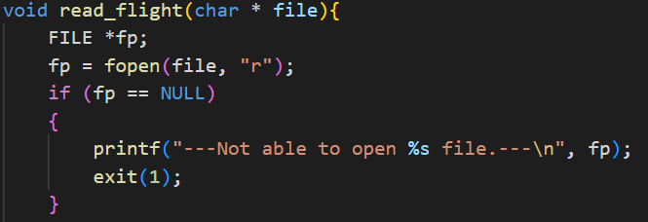
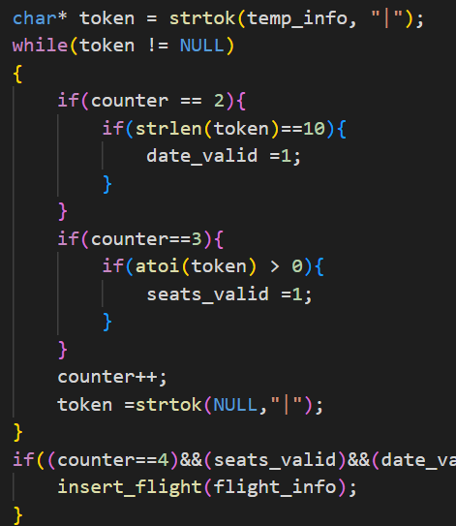
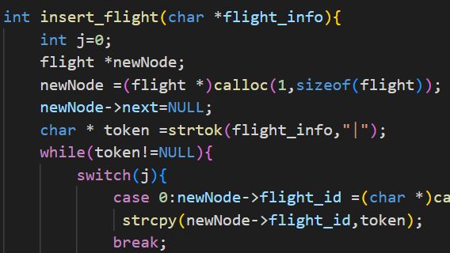
BRIEF DESCRIPTION OF CODE (READ_FLIGHT FUNCTION)
FL001|Indigo Airlines|02/10/2022|120
Notes:
Coming to read_flight function we start by opening the flights.dat file then we scan the first line from the file and tokenize it with pipe character “|”. Then we take each tokenized parameter and check if each of the parameter is valid. If the flight has all valid parameters then we create a new node with the scanned flight details and add this node to the fligh_details linked list.

Slide 12
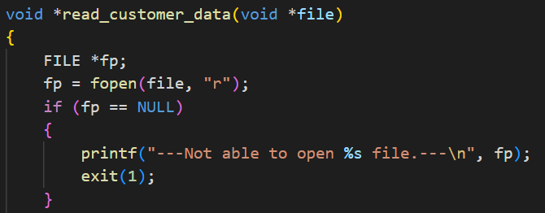
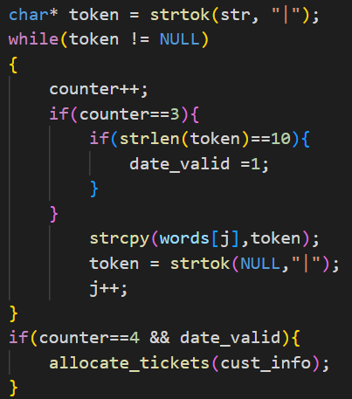
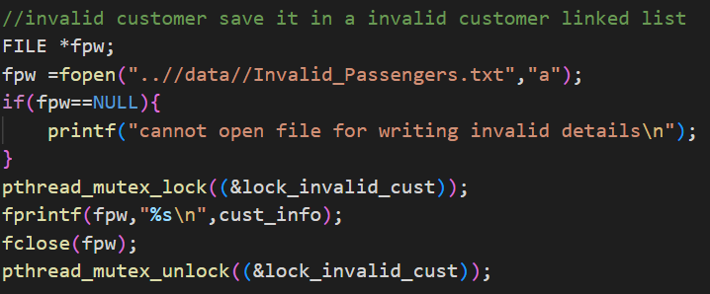
BRIEF DESCRIPTION OF CODE (READ_CUSTOMER_DATA)
CD001|Pravesh|22/10/2022|12
Notes:
Coming to read_customer_data function we start by opening the agent.dat file then we scan the first line from the file and tokenize it with pipe character “|”. The we check for each tokenized parameter and check if each of the parameter is valid. If the customer has all valid parameters then pass on the scanned data to allocate_tickets functions. If the either one of the customer details are not valid then we add this data to Invalid_passengers.txt file.

Slide 13
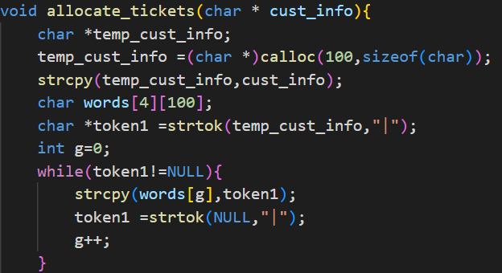
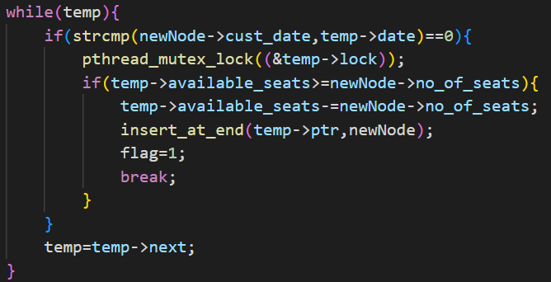
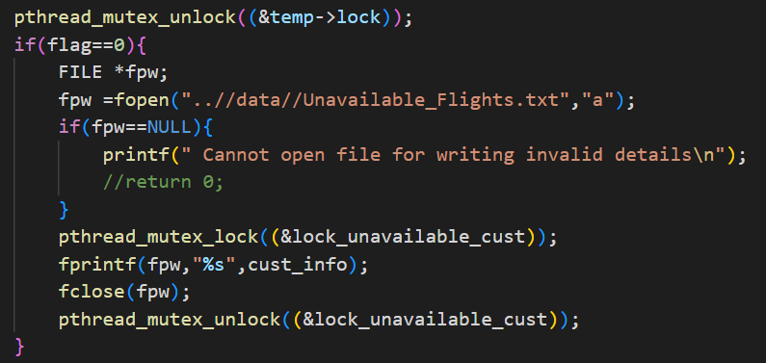
BRIEF DESCRIPTION OF CODE (ALLOCATE_TICKETS)
Notes:
Coming to allocate tickets function. This function has valid customer input so we tokenize it with pipe character and store them in a 2D char array named words.
After that we we copy the information to a newnode. We then create a temp to point to the flight_details, head. Now we scan the flight details linked list using temp and them compare if the newnodes date the flights date are same and it they are same then we allocate the tickets and subtract the tickets from available_seats and insert the newnode at end of the customer linked list of the flight. While allocating the tickets we also use a mutex lock. If the tickets are not available then we add the customer details to the unavailable_flights.txt

Slide 14
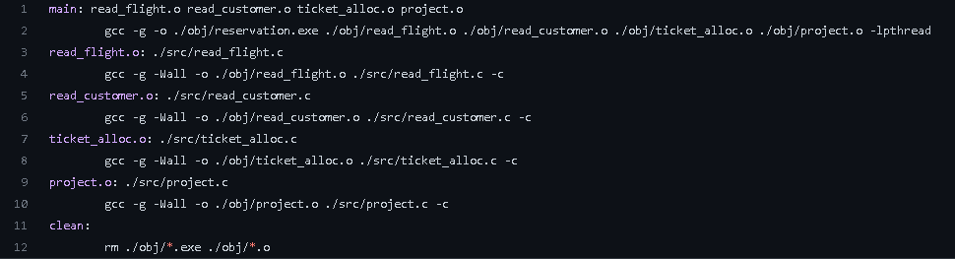
Make file

Slide 15
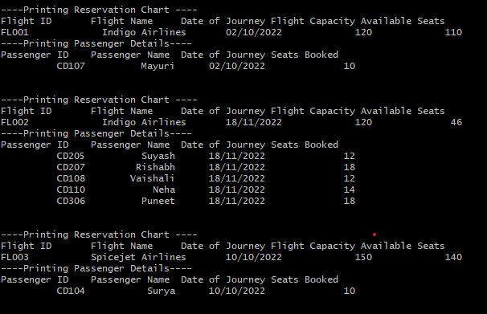
RESERVATION CHART OF A FLIGHT

Slide 16
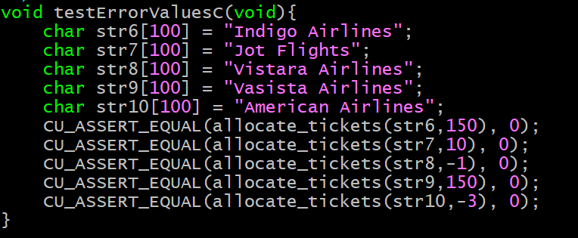
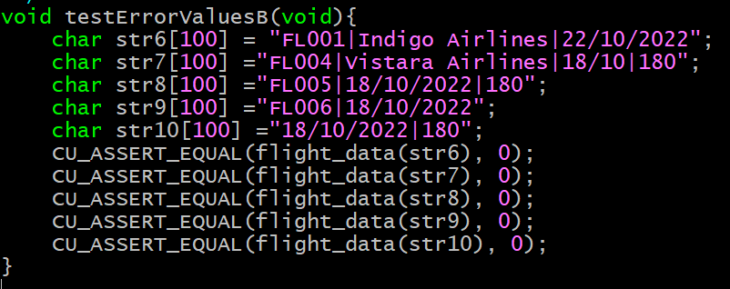
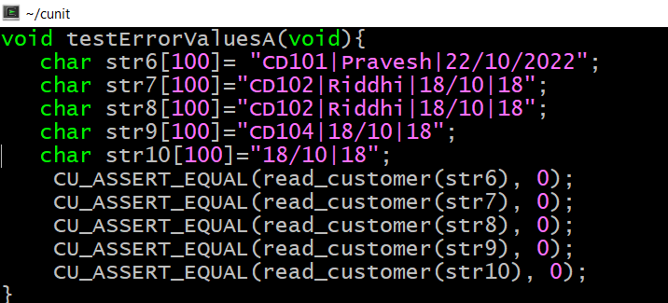
CUNIT

Slide 17
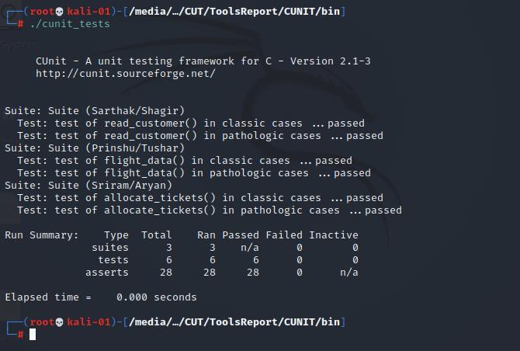
CUNIT

Slide 18
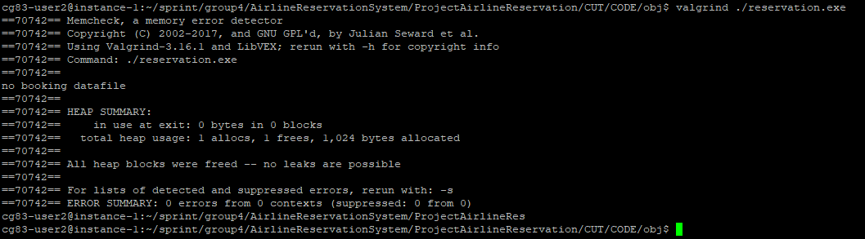
Valgrind

Slide 19
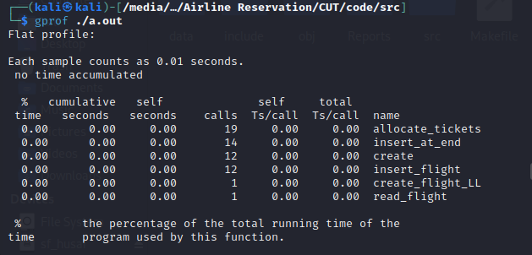
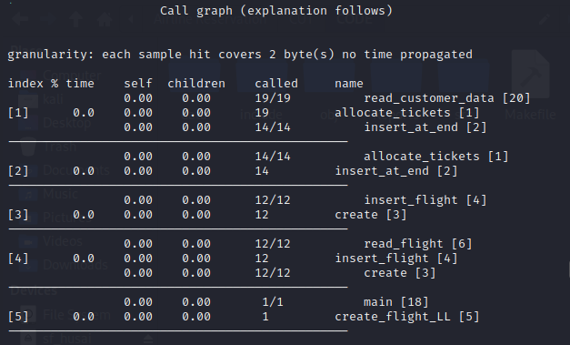
Gprof

Slide 20
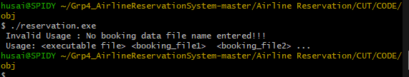
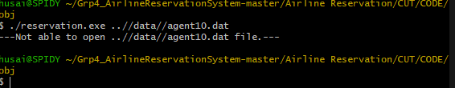
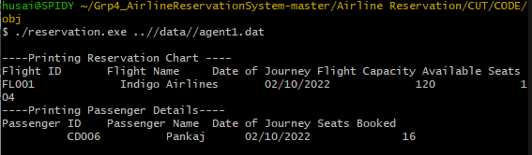
Integration Testing
User does not provide even one customer data file:
User provides file name that doesn't exist in project directory:
User provides at least one customer data file:

Slide 21
THANK YOU
-Shagir Husain -Aryan Tiwari -Prinshu Raj -Sarthak Srivastava -Sriram Repaka -Tushar Gautam

